Slide 1
RASPBIAN
PRESENTATION BY OLIVIER WINKLER

Slide 2
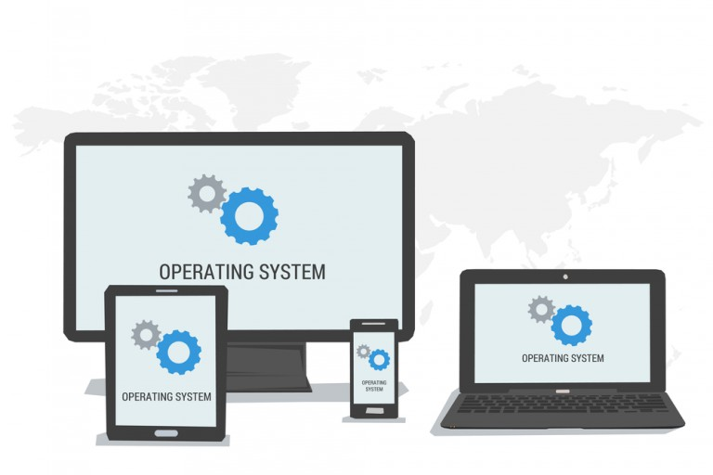
WHAT IS AN OPERATING SYSTEM?
An operating system is software that manages the hardware and the software resources of the computer for computer programs
A device needs a operating system for executing programs

Slide 3
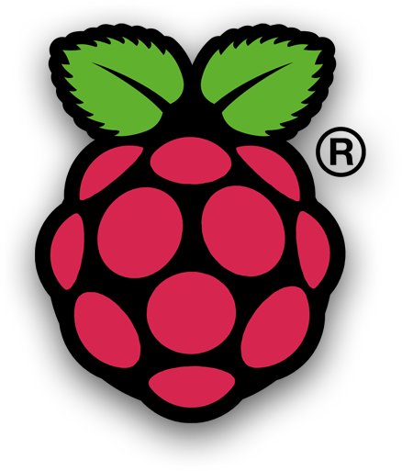
What is Raspbian?
Free operating system for Rasperry Pi
Based on Debian 9 (Linux)
Size: 4GB (about 35’000 packages)

Slide 4
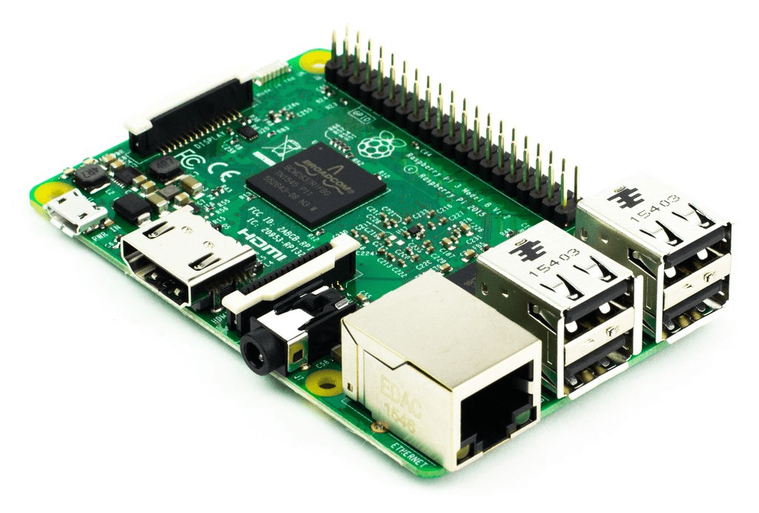
History
Created by a small team of developers that are fans of the Raspberry Pi
The basic build was completed in June of 2012
Since 2015 Raspberry Pi Foundation officially provides Raspbian

Slide 5
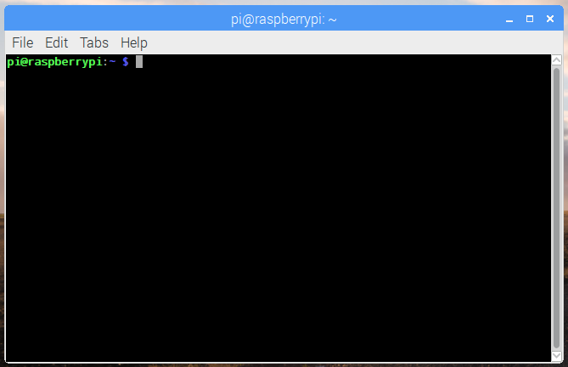
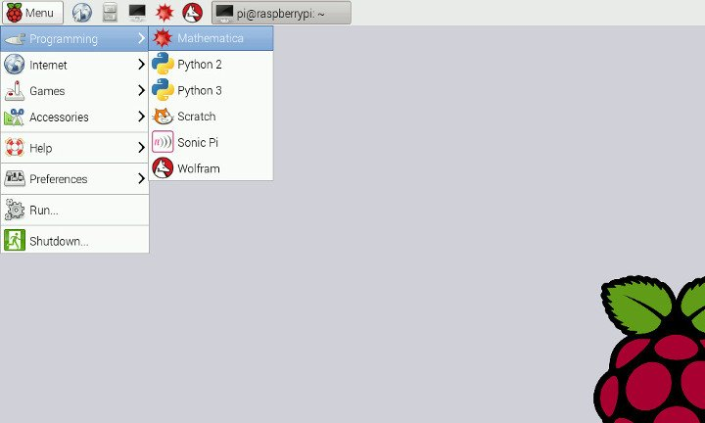
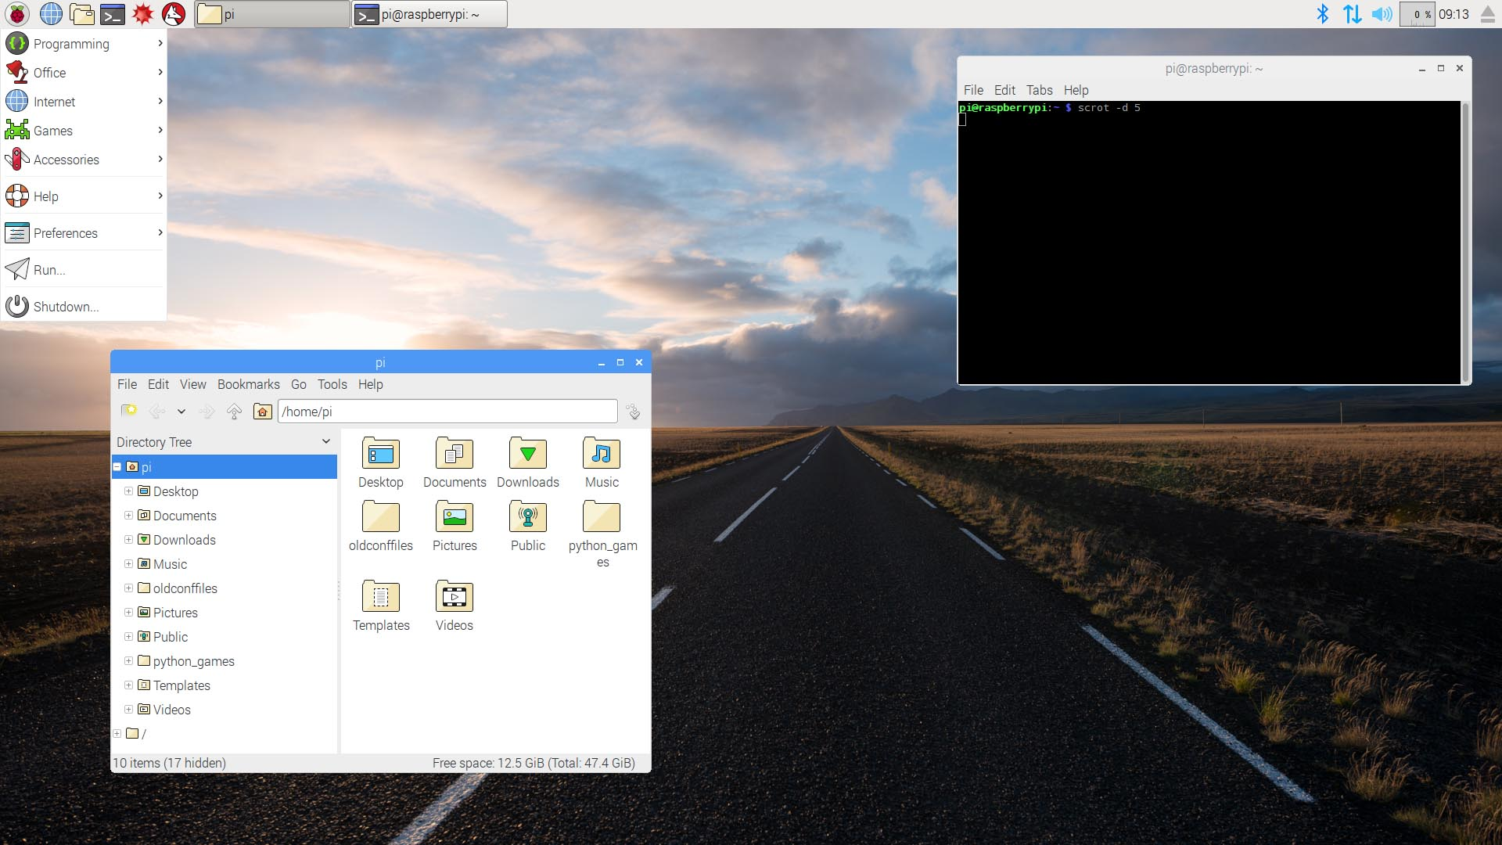
User-interface
Terminal LXDE-Desktop PIXEL
Lightweight X11 Pi Improved Xwindows
Desktop Environment Environment Lightweight

Slide 6

Questions?

